Slide 1

Medical Question Generation for Pre-Consultation
Using NLP to Generate Personalized Questions for Patients Before Doctor Visits
Presented by: Philopater Ayman DR. Ensaf Hussein TA. Ziad Elshaer

Slide 2

Why is This Project Needed?
Time Constraints
Incomplete History
Limited time during initial consultations
Missing patient details can cause misdiagnosis
Project Goal
Automate relevant, context-aware question generation

Slide 3





Benefits of the System
Time-Saving
Streamlines data collection before visit
Quality Data
Improves information accuracy pre-consultation
Patient Preparedness
Enhances patient engagement and readiness
Reduces Physician Load
Decreases cognitive burden on doctors

Slide 4
Technical Approach
Models Used
Techniques
Gemma (Google)
4-bit Quantization
SILMA-Kashif (Arabic LLM)
QLoRA Fine-tuning
Few-shot Prompting

Slide 5




Dataset & Preprocessing
Data Source
Preprocessing
Data Split
Ahmed-Selem/Shifaa Arabic Medical Consultations (Hugging Face)
Instruction-based formatting, prompt-response structure
80% training, 20% testing

Slide 6
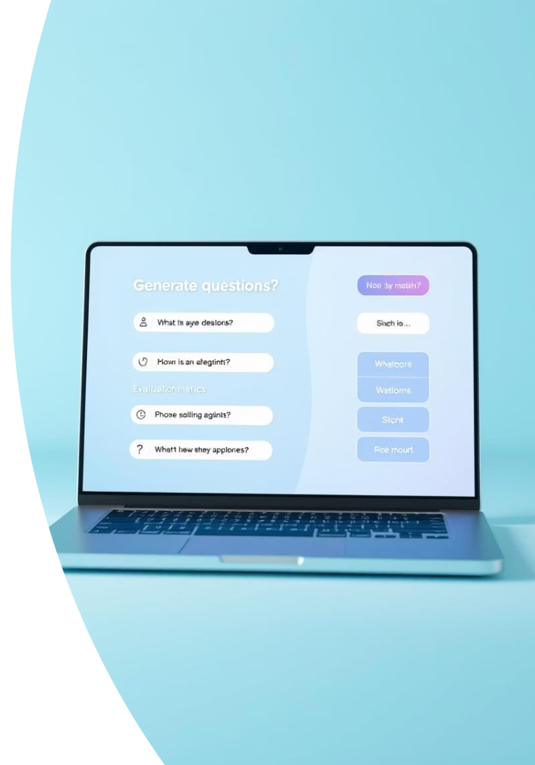
Inference & Evaluation
1
Process
2
Evaluation
Loaded fine-tuned adapters, applied few-shot prompting
Gemini API as judge model scoring relevance, clarity, completeness
3
Scores Range
Scale from 0 to 100

Slide 7
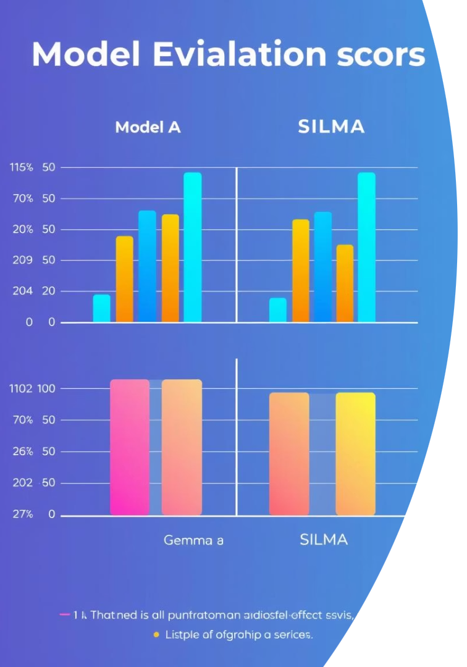
Results Summary
Sample
Gemma Score
SILMA Score
1
70
58
2
72
57
3
68
61
4
71
60
5
72
59
Gemma outperformed SILMA in depth and relevance. Few-shot prompting enhanced quality.

Slide 8
Conclusion & Future Work
Achievements
Future Directions
Automated pre-consultation question generation
Support multiple languages
Effective use of QLoRA & few-shot prompting
Platform integration in healthcare
Improved clinical workflows potential
Explore lightweight deployment

